Slide 1
The basics of dynamic multithreading
Multithreaded matrix multiplication, Multithreaded merge sort

Slide 2
Basics of dynamic multithreading
Serial Algorithms
Parallel Algorithms
Dynamic multithreading allows programmers to specify parallelism in applications without worrying about communication protocols, load balancing, and other vagaries of static-thread programming.
Dynamic multithreading support two features: nested parallelism and parallel loops.
A key aspect of this model is that the programmer needs to specify only the logical parallelism within a computation, and the threads within the underlying concurrency platform schedule and load-balance the computation among themselves.

Slide 3
Basics of dynamic multithreading
dynamic multithreading offers several important advantages:
It is a simple extension of our serial programming model. We can describe a multithreaded algorithm by adding to our pseudocode just three “concurrency” keywords: parallel, spawn, and sync.
It provides a theoretically clean way to quantify parallelism based on the notions of “work” and “span.”
Many multithreaded algorithms involving nested parallelism follow naturally from the divide-and-conquer paradigm
A growing number of concurrency platforms support one variant or another of dynamic multithreading, including Cilk , Cilk++, OpenMP, Task Parallel Library , and Threading Building Blocks .

Slide 4
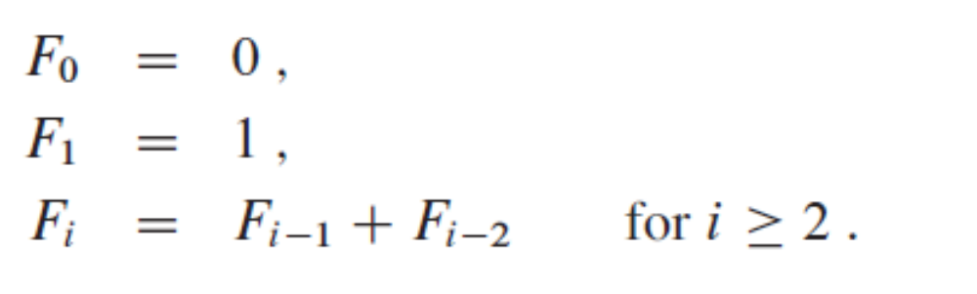
The basics of dynamic multithreading
Example—Fibonacci numbers

Slide 5
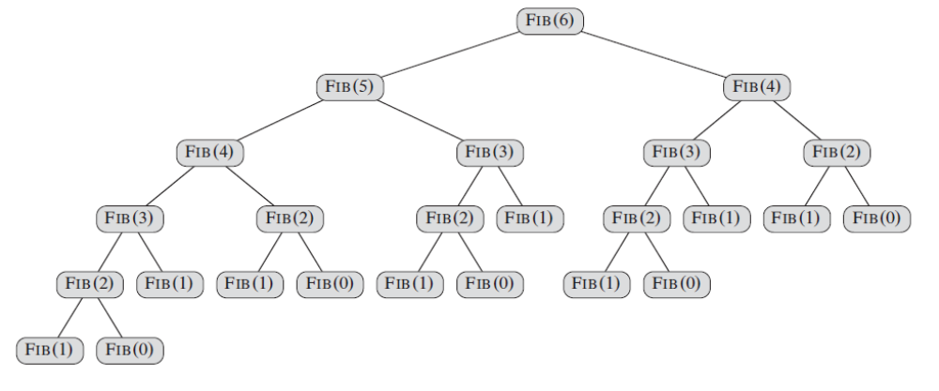
The basics of dynamic multithreading
Example—Fibonacci numbers -Tree of recursive procedure

Slide 6
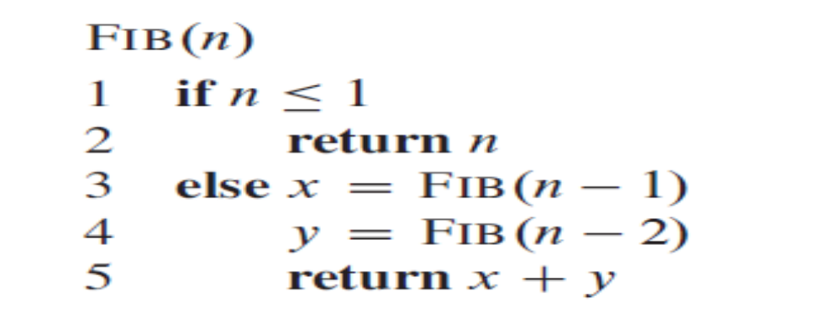
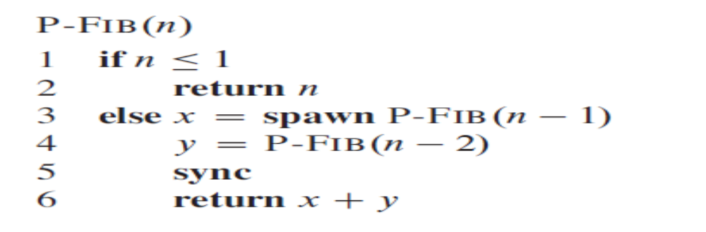
The basics of dynamic multithreading
Example—Fibonacci numbers
Using Multithreading

Slide 7
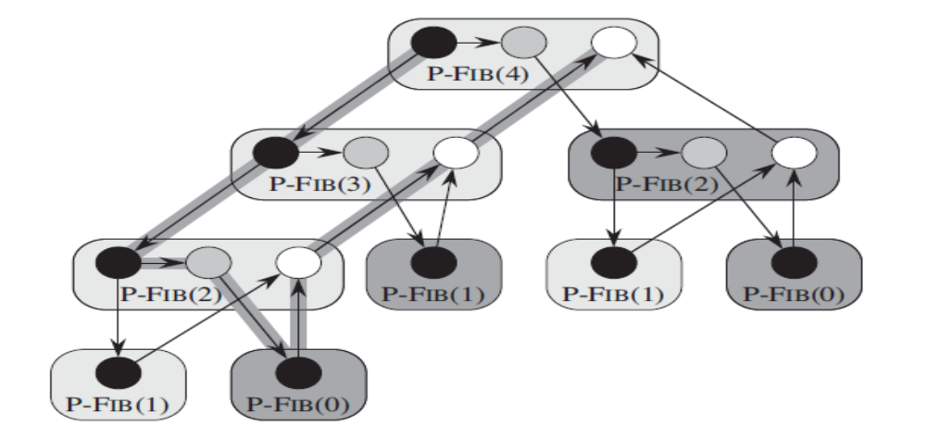
The basics of dynamic multithreading
Directed Acyclic graph of fib(4)

Slide 8
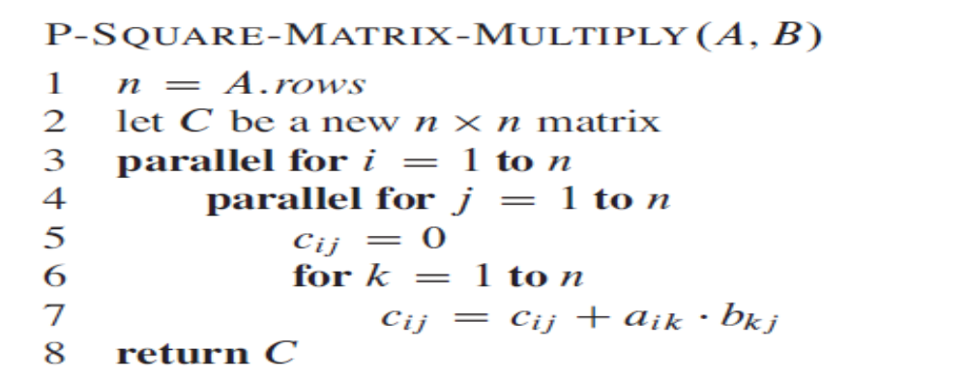
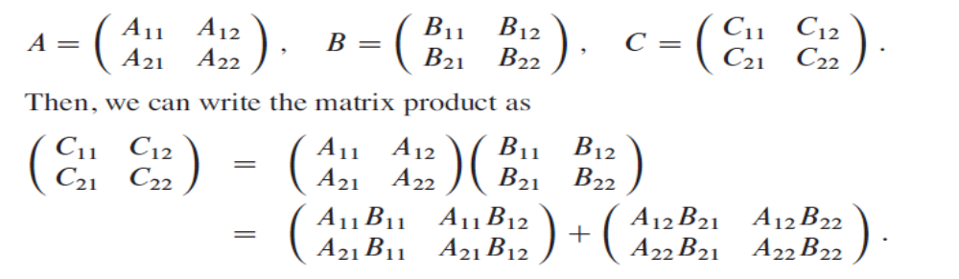
Multithreaded matrix multiplication

Slide 9
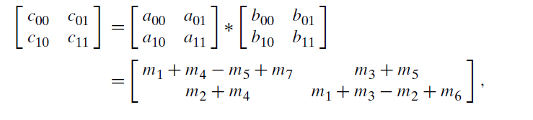
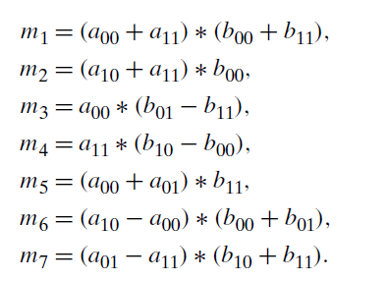
Strassen’s matrix multiplication

Slide 10
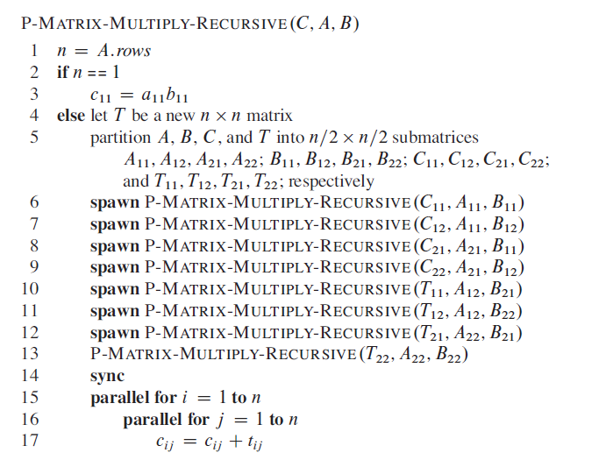
Multithreaded matrix multiplication

Slide 11
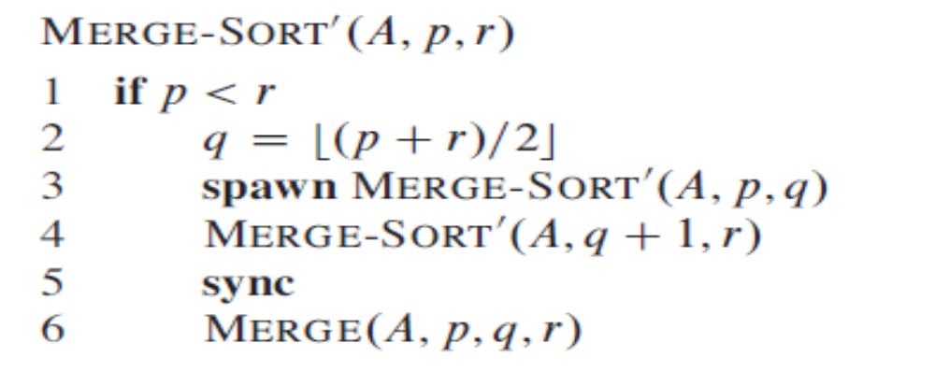
Multithreaded mergesort

